Slide 1
Entrant Essentials 1: Arriving to the University of St Andrews
Disability Webpage​
disability@st-andrews.ac.uk​
01334462020

Slide 2
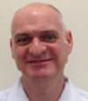
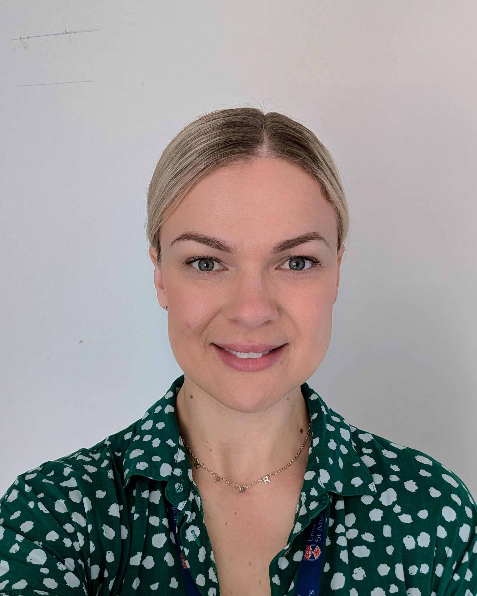
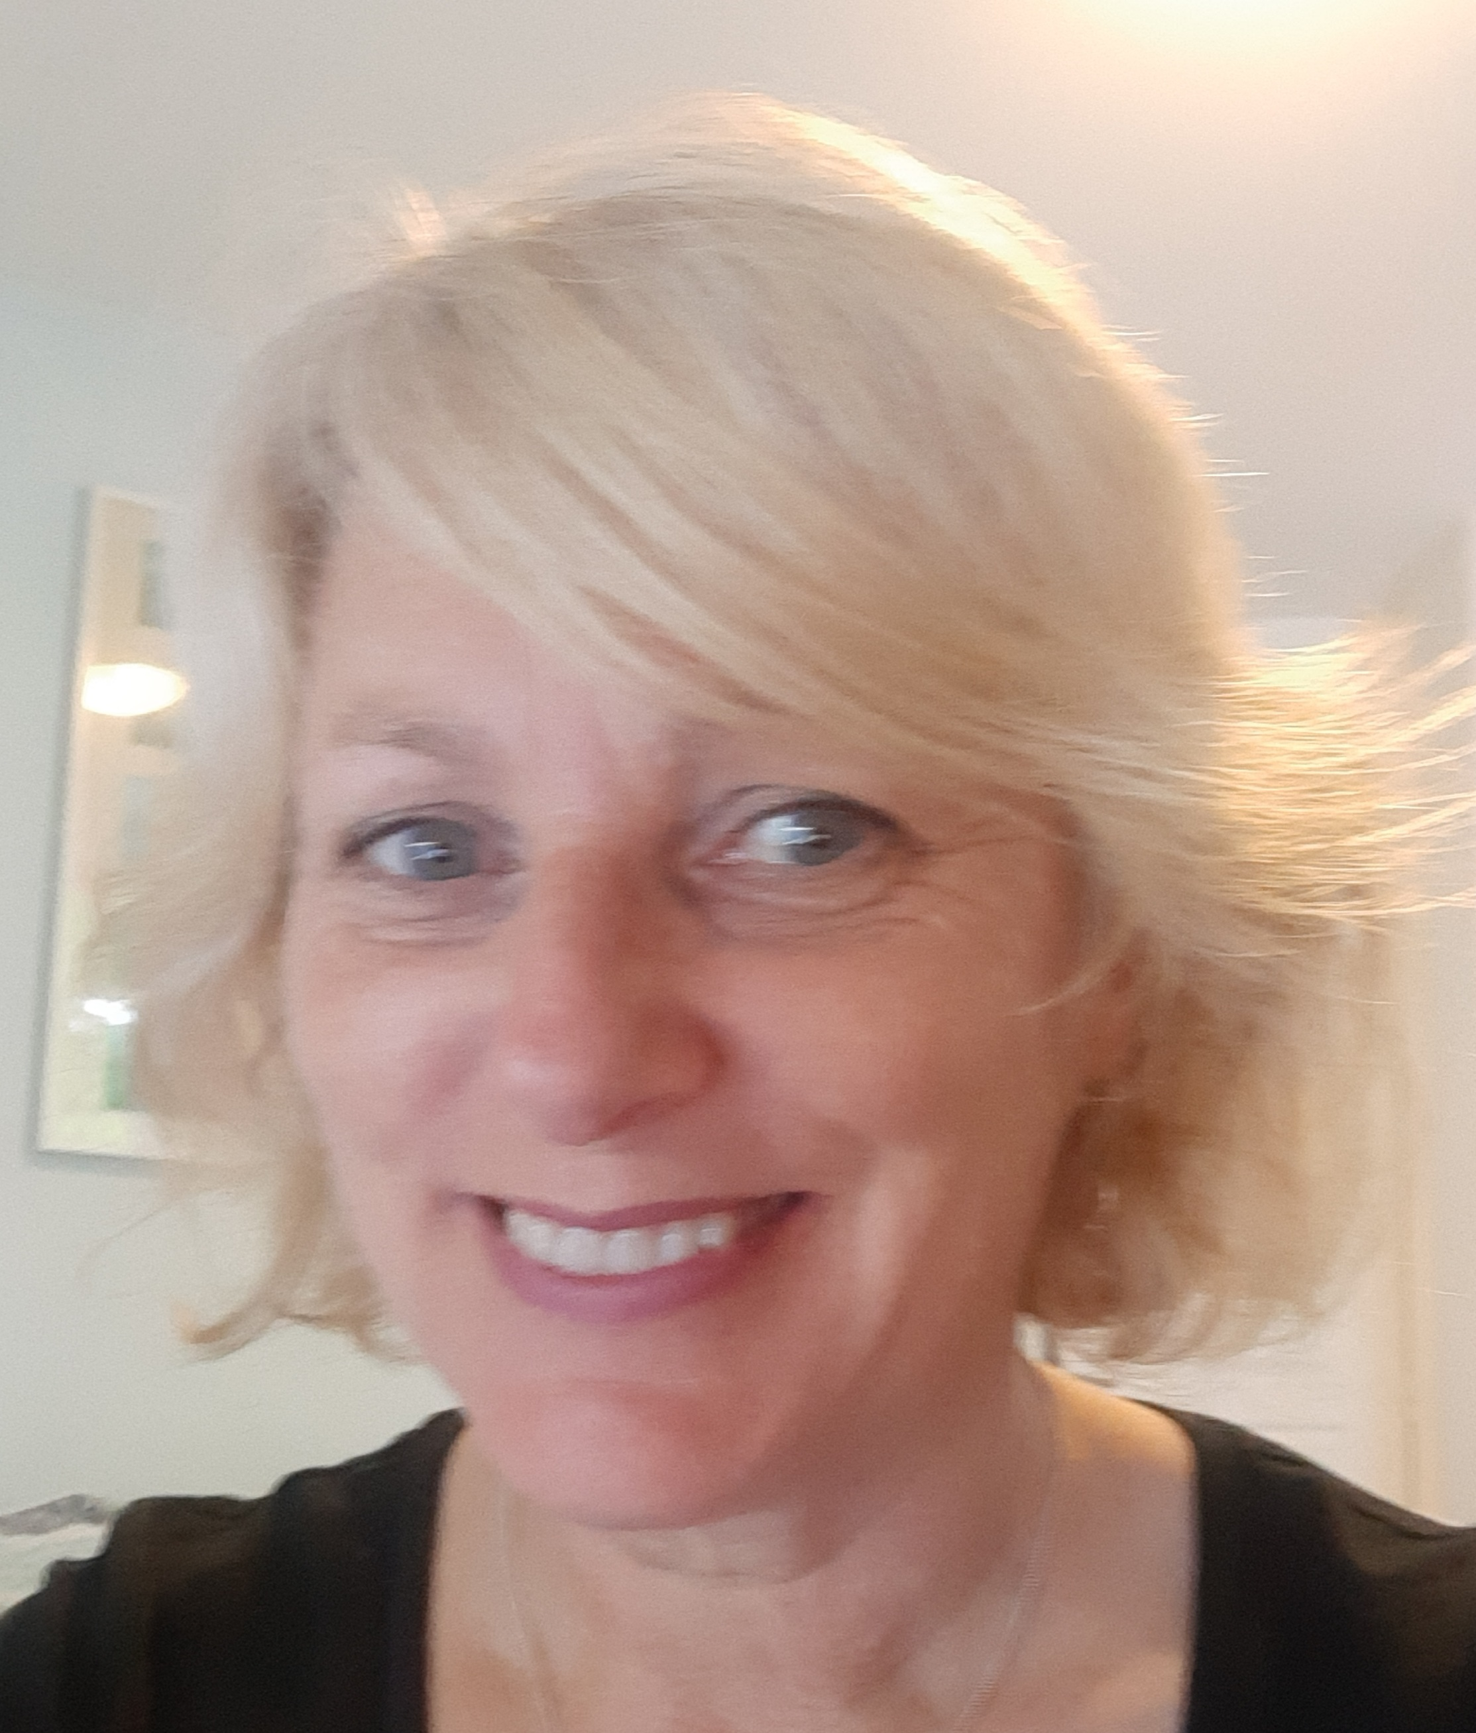
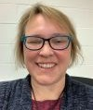
Student Services Disability Team
Director of Student Services
Dr Lara Meischke​
Assistant Director –
Sarah Scott
Disability Advisers – John Petrie, Michelle Petrie, Kate Leavy​, Kim Cartright, Stephanie Beaumont, Katie Easton, Delyth Henderson
Digital Accessibility Adviser – Ros Walker

Slide 3
Making Contact with the Disability Team
Range of services offered
Information and documentation required
Disability Students Allowance (DSA)
Contact details:
01334462020
disability@st-andrews.ac.uk
https://www.st-andrews.ac.uk/students/advice/disabilities/

Slide 4
What to expect when you meet with us
Introductions
Explanation – what the disability team do
Documentation
Disability support plan
Accessibility
Disabled Student's Allowance, Uk students and if eligible
Opportunity to ask questions
Follow up details

Slide 5
Student Services
Buildings at Eden Court and the The ASC on North Street
Can help with academic and non–academic questions
Services:
Disability advice and support
Money advice
Wellbeing support
Counselling
Out of hours
Wardennial Service
Health Hub

Slide 6
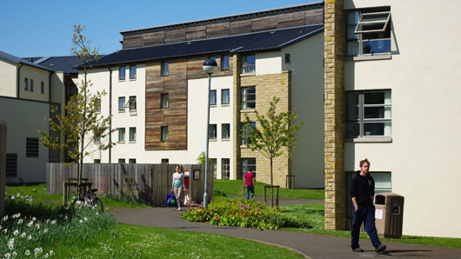
Planning your arrival
Student Accommodation
Information about your hall of residence
What can I bring
What should I pack
Bedding packs
Inventory
Student accommodation FAQs

Slide 7
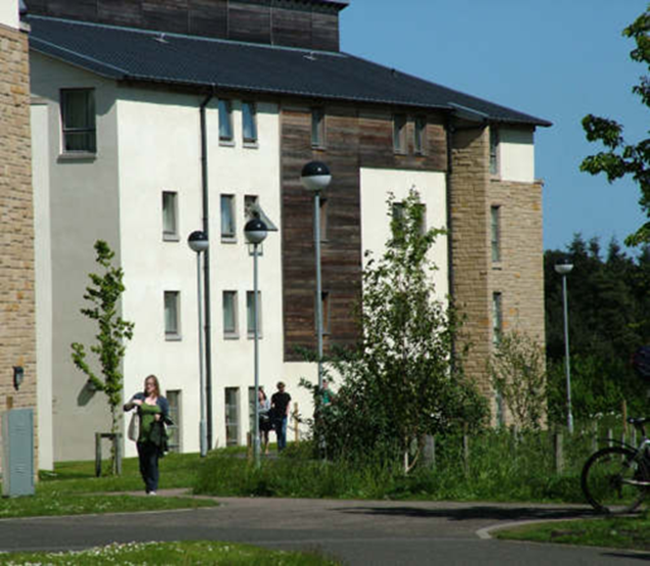
Accommodation Essentials
Residence Management Team
Housekeeping and Porter Team
Wardennial Team
Chef Manager and Catering Team
Senior Student and Hall Committee
Communal areas
Shared living basics
The working of a hall

Slide 8
Orientation Essentials
What is orientation?
Who can help me?
Peer orienteer support

Slide 9
Matriculation
What is matriculation?
Matriculation process
Matriculation event – Gateway building
Online matriculation element
Advising
Core student training

Slide 10
Student Union, Freshers’ Fayre and Events
Student Union
Freshers' and Sports Fayre
Freshers week events
Academic families
Getting around St Andrews

Slide 11
Mentoring and Peer Support
Transition support
Mentoring schemes
Peer support

Slide 12
Communication with parents

Slide 13
Some things to consider before you arrive
Have you been in touch with a Disability Adviser to discuss your support requirements?
If you haven’t yet, contact the Disability Team to discuss your support requirements before your course begins.
Have you sent information about your diagnosis?
Have you applied for Disabled Students’ Allowance, if applicable (UK students only)?
What would you like to know more about? Let us know so that we can give you information, advice and reassurance.
Read the Universities guidance on “before you depart” including what to pack, maps and lots of other useful information.

Slide 14
Any questions?

Slide 15
Thank you for joining us!
Please join for the next webinar in the series, Entrant Essentials 2: What you need to know about Teaching and Learning at St Andrews on Thursday 31st at 2PM BST

