Slide 1



Delivering the Access to Work Mental Health Support Service

Slide 2


_Access to Work Mental Health Support
Part of Ingeus UK Group, oversee Access to Work in England, Scotland & Wales
Gap for long term workplace Mental Health support offer.
Already supported over 9,500 people with a vast range of Mental Health issues.
Specialists in corporate health, wellbeing and employability services.
Deliver EAP services, workshops, webinars + staff training.
Service provider for Access to Work across Scotland –
July 2021 onwards.
Fully funded service for both employers + employees.
No contracts/obligations or hidden costs.
5-year contract, from July 2018-2023 – likely extension on this.

Slide 3
_Eligibility and Suitability Check
_Eligibility Criteria:
Aged 16 or over.
In paid employment - self-employed, temporary or permanent, apprenticeship, internship, or casual.
Attending work, off sick or furloughed.
Having problems managing their mental health - diagnosed or not.
_Suitability Criteria:
Mild to moderate Mental Health Issues – stress, anxiety, sleep issues, COVID-19 fears.
NOT a full counselling service or those with severe Mental Health issues.
Up to 9 months of structured support, advice and guidance from a Mental Health professional.

Slide 4
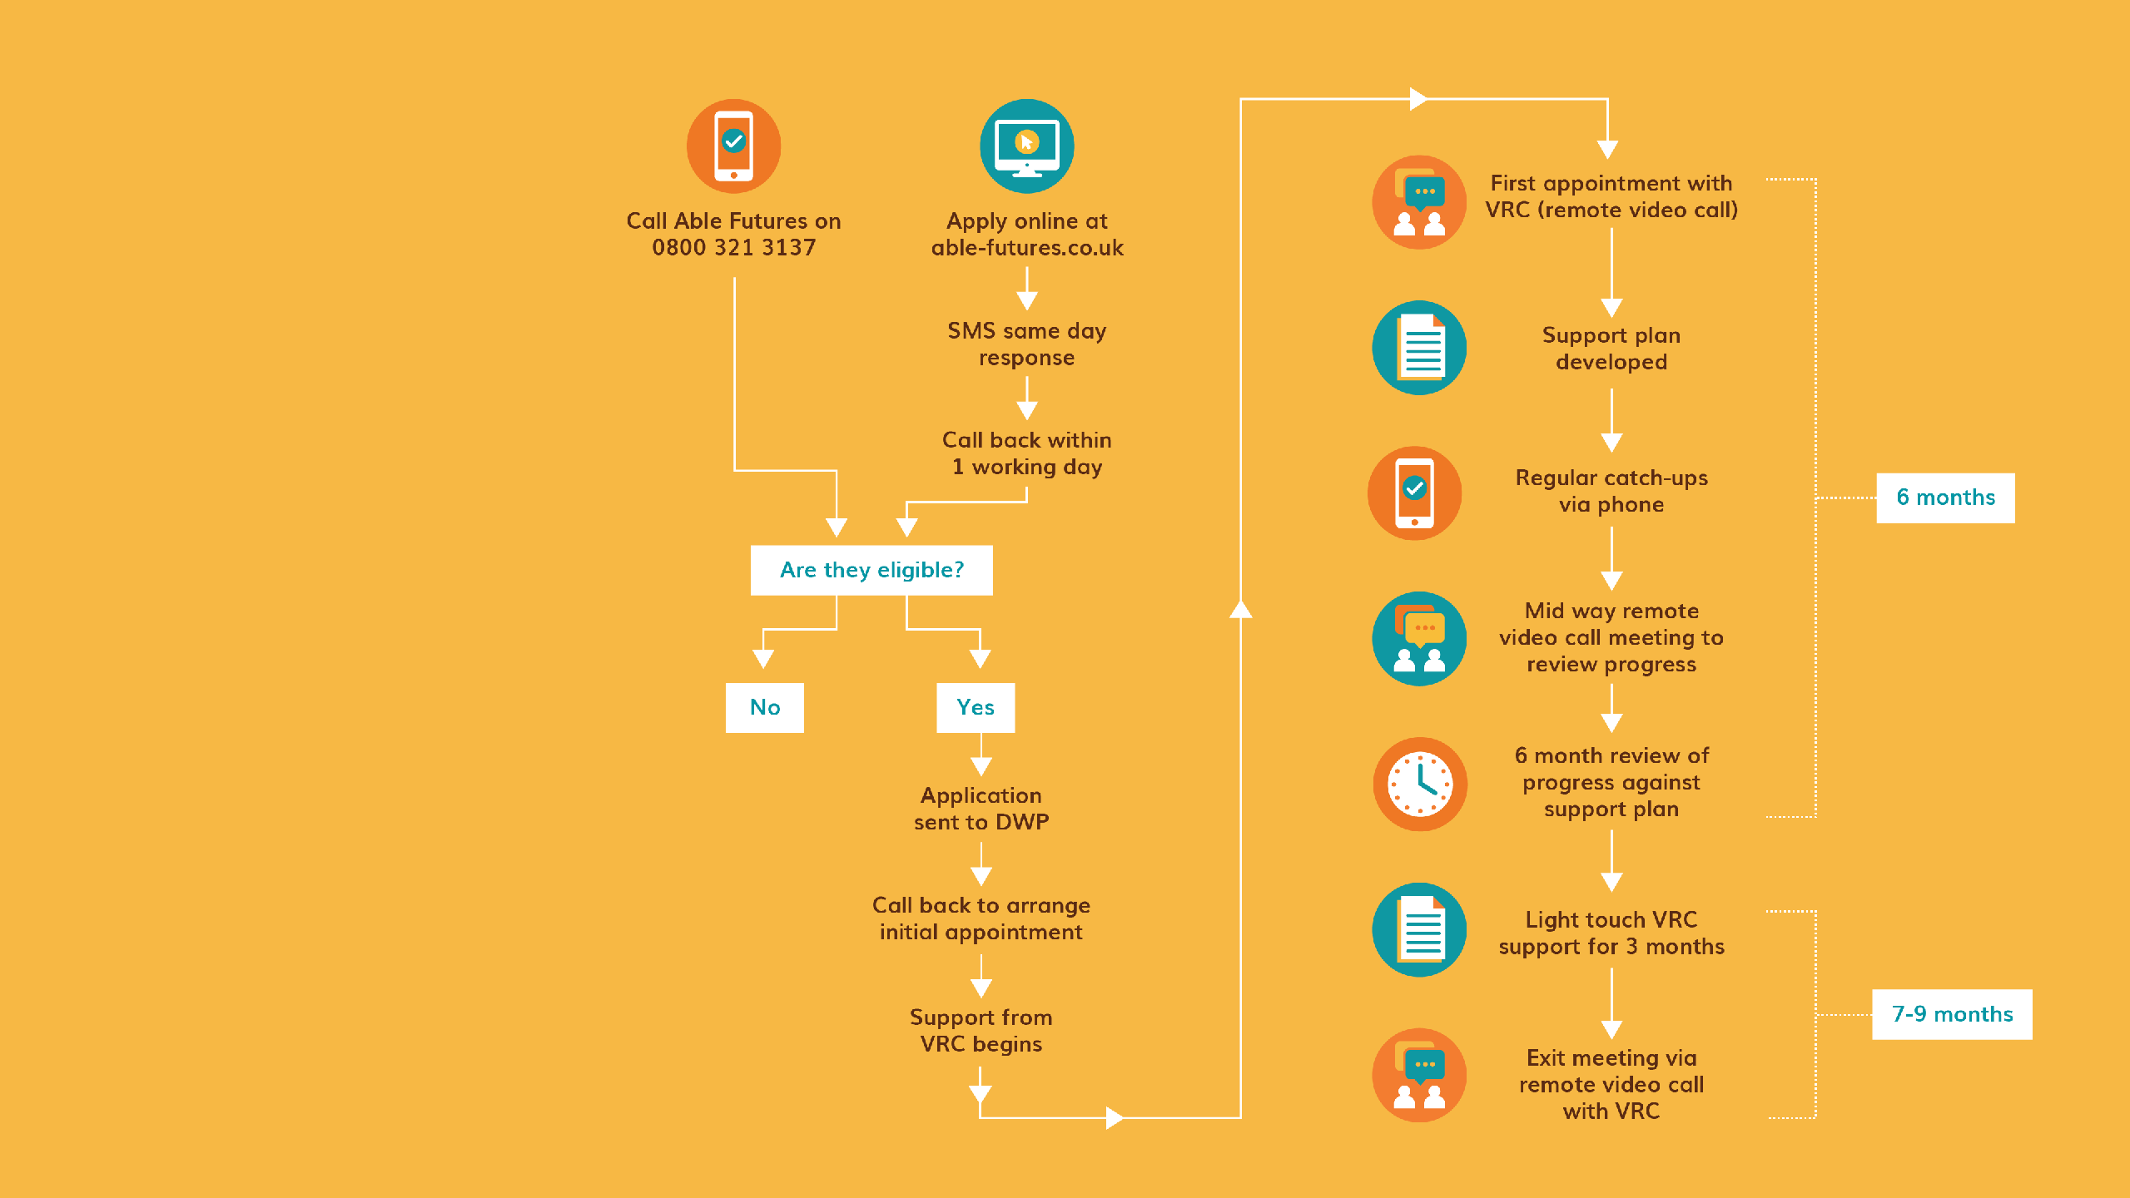

_Once employees have applied
Call back within one working day from Able Futures – if applied online.
Eligibility and suitability checks, ‘Annex A’ form completed.
Application sent to DWP for approval – between 2-5 working days.
TBHG UK will make contact to arrange an initial appointment within 48 hours of approval.

Slide 5


_How Able Futures can support Mental Health at work.
1-to-1 Support from a dedicated Vocational Rehabilitation Consultant (VRC)
Fully qualified and experienced Mental Health professionals.
Delivered over the phone, or via TEAMS call.
Long-term Mental Health support.
Focus on building skills and resilience.
Information, guidance, support, signposting and coping strategies.
Completely confidential.
The VRC can also assist in the dialogue between employee and employer.
May suggest reasonable adjustments at work, on occasion.

Slide 6

_A Support Plan for you
Plan of support tailored to their needs
Up to nine months 1-2-1 Mental Health support
Months split into ‘Six and Three’
Focus on coping strategies
Hour-long appointments with their VRC
The Support Plan could focus on:
Stress + Anxiety
Time management
Bereavement
Organization and planning
Coping with change
Anger management
Relaxation + mindfulness
Managing emotions
Developing a sleep routine
COVID-19
Financial management Reasonable adjustments
Panic attacks
Resilience + capacity building

Slide 7



_The next steps for employers
A dedicated Business Account Manager to support you
in embedding Access to Work awareness and support.
A suite of digital marketing materials from Able Futures, including posters, leaflets, intranet content and tailored emails.
Introductory sessions for Leadership and HR teams, plus information sessions for Mental Health First Aiders & ‘Wellbeing Warriors’
Virtual Appointment Days
- pre-booked 30-minute appointment with TBHG, for self-referral at their own pace.

Slide 8

_Any questions?
Find out about other people that have used Able Futures.
www.able-futures.co.uk/case-study/

Slide 9
_Able Futures Results
Able Futures has supported more than 9,500 people across England, Scotland and Wales with mental health issues including anxiety, depression, stress, bereavement, financial worries, sleep problems and more.
We are supporting individuals in roles including administrators, call handlers, cleaners, drivers, healthcare workers, managers, team leaders, teachers, waiters and more.
_What our participants say
“It’s nice to have someone to talk to. They offered good advice, especially when speaking to my employer."
“My GP is difficult to get hold of and they offered alternative advice – try this and have you thought
of that."
“Most importantly was the consistent telephone calls and face-to-face meetings; the meetings provided a useful resource. I felt empowered to do things."

